Slide 1

UE20CS390A – Capstone Project Phase – 1
END SEMESTER ASSESSMENT
Project Title : Voice Interface for PESU using AI
Project ID : PW23_PB_01
Project Guide : Prof. Priya Badrinath
Project Team with SRN : 805_806_826_844

Slide 2
Abstract and Scope
  Abstract: The voice assistant will be designed to help student with various academic and administrative task such as, finding courses, checking grades, accessing other resources like time table.
  Scope: The voice assistant will be developed using natural langue processing (NLP) and machine learning algorithm, which will enable it to understand and respond to user requests.
        Easier access to PESU resources
        Get the latest information about academics
        Tap talk and get wherever you wish in PESU academy.

Slide 3
Suggestions from Review - 3
Suggestions and remarks given by the panel members.
Removing some of features like Voice Authentication and Web scraping.
Creating the database, Instead of Web Scraping.

Slide 4

Our key features now are
ISA/ESA Results
And Marks
Attendance
Courses
Timetables of ESA/ISA

Slide 5
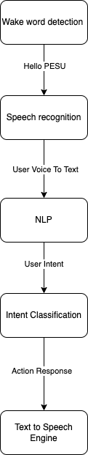
Design Approach
Here we have opted simple voice assistant design approach as suggested by panel members consists of several key components.
  Including wake word detection
  Speech recognition
  Natural language processing (NLP)
  Intent classification
  Action generation
  Text-to-speech.
The assistant listens for a specific wake word i.e. “Hello PESU”, then records the user's voice and converts it into text using a speech recognition engine. The text is processed using NLP to understand the user's intent, and the intent is classified to determine the appropriate action or response. Finally, the response is generated and played back to the user in the form of audio using a text-to-speech engine.

Slide 6
NLP Module
We use the Python Speech Recognition library to convert the user's voice input into a desirable text format.
Natural Language Processing (NLP) will be used to convert normal language queries into database queries by leveraging various techniques such as :
Tokenization
Part-of-speech tagging
Named entity recognition
Query generation
Query execution

Slide 7
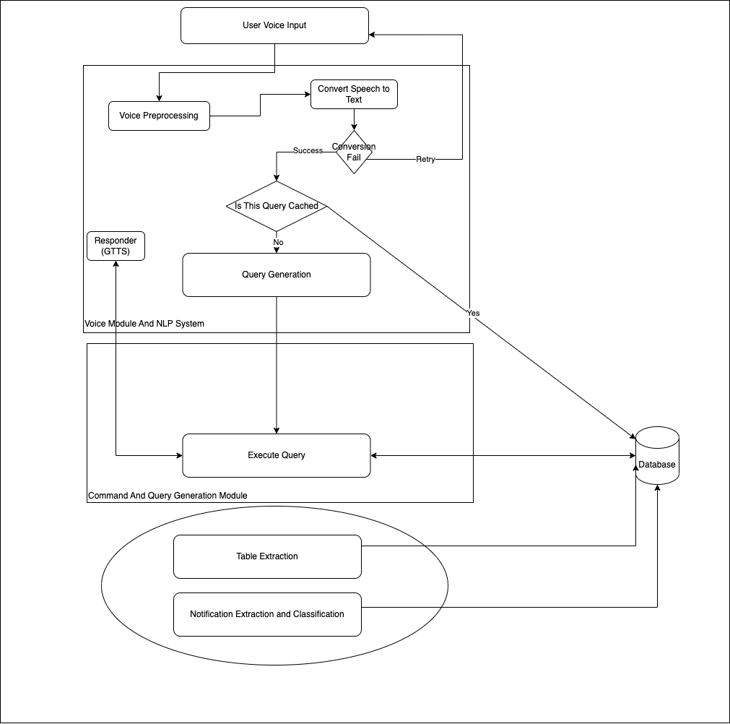
Design Approach
Student Voice is given as input and it is sent to server .
Server pre-processes the voice for reducing noise, converts into intents and checks if it is cached or not.
If not, request is made to command module which takes intents and arguments as input and generates database query, which is then executed and result is sent to user and narrator narrates the results.
For every time period, Table extraction, fetching of marks, attendance are done.

Slide 8
Design Approach
As you can see in image you need to upload documents.
Trained model will check for its quality. after converting to from pdf to image.
Then document scanner will scan the document pre-process the image.

Slide 9
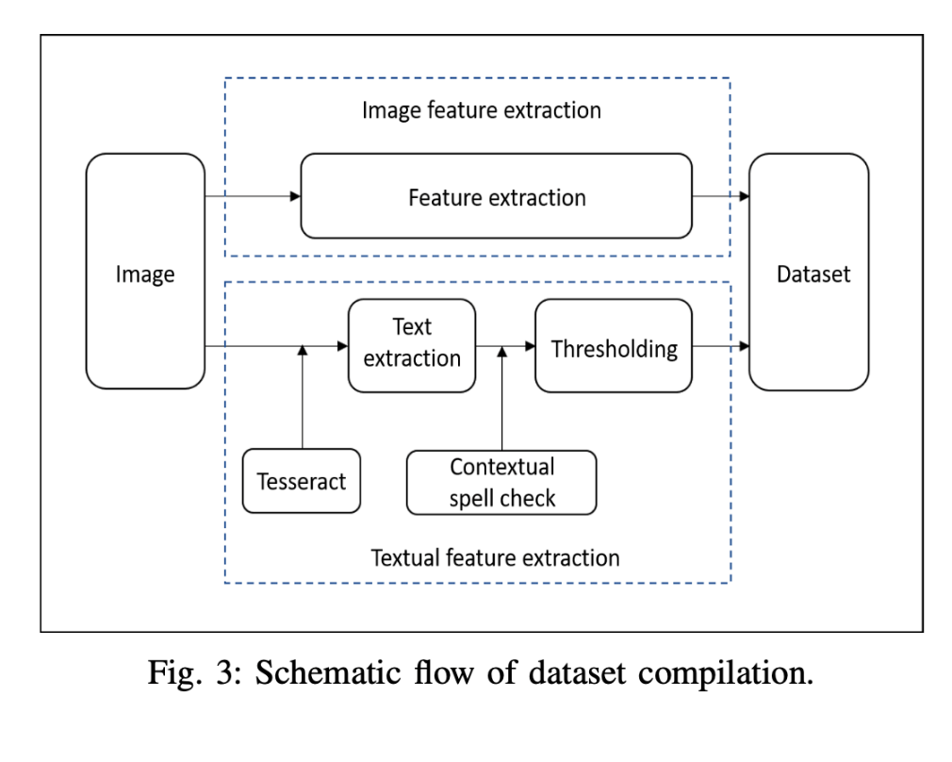
Design Approach
Data Extraction:
In order to, extract data from image Image has to be in good quality. That’s why we are using Logistic Regression to classify image as good or bad. Accuracy of Logistic Regression model was 83%
For Extraction of data from. We are going to use OpenCV and PY tesseract for text extraction from each cell.

Slide 10
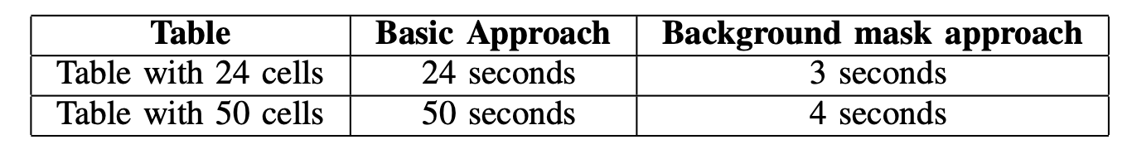
Design Approach
Then Cells are detected and text are extracted and csv/json/txt/excel is generated.
Logistic regression is used for quality checks
Performance is optimized by creating background mask is created by calculating the size of height and width from all the cell ROI crops
OpenCV is used for perform Warp perspective, cell detection, pre-processing etc

Slide 11
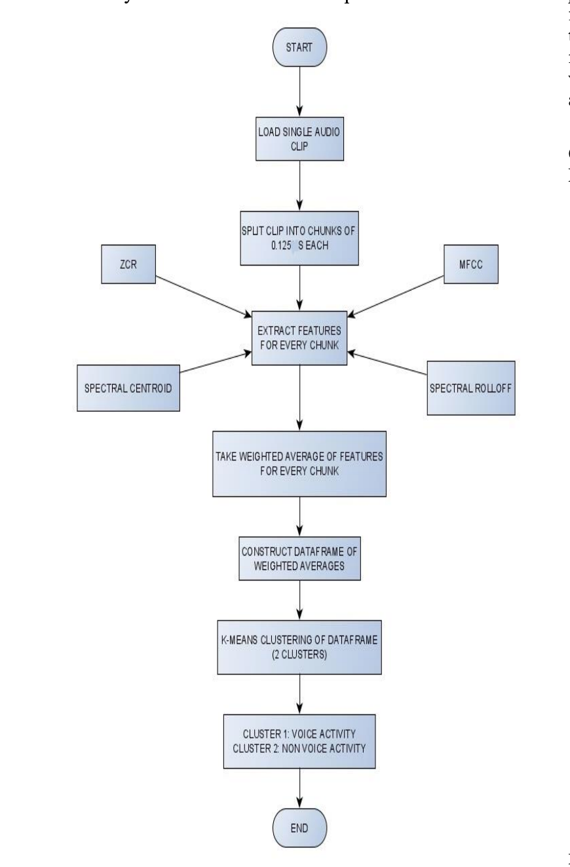
Literature Survey
Working model is simple, audio is broken down into .125 seconds clip, fed to feature extraction algorithm.
Then, weights are added and passed to KNN, KNN classifies as human voice and non human voice.
Audio Features : -
Mel-Frequency Cepstral Coefficients
Spectral Roll – Off
Spectral Centroid
Zero Crossing Rate
Source:- A Method for Voice Activity Detection using K-Means Clustering
2022 conference paper

Slide 12
Literature Survey
What do these features tell us
  The pitch of the sound: Spectral Centroid and MFCCs can help identify the pitch or fundamental frequency of the sound.
  The timbre of the sound: MFCCs can help to identify the timbre or quality of the sound, such as whether it is a voice, a musical instrument or noise.
  The rhythmic structure of the sound: Zero Crossing Rate can help to identify the rhythmic structure of the sound, such as how often it repeats.
  The overall shape and texture of the sound: Spectral Roll-Off and Spectral Centroid can help identify the overall shape and texture of the sound, such as whether it has a lot of high-pitched or low-pitched frequencies.

Slide 13
Literature Survey
Drawback
There are numerous avenues opened by this unsupervised learning approach. Such as expanding the capability of the model to identify and label different types of noise, developing an ensemble-based model with deep learning-based solutions to achieve higher accuracy, and performance evaluation in various scenarios.

Slide 14
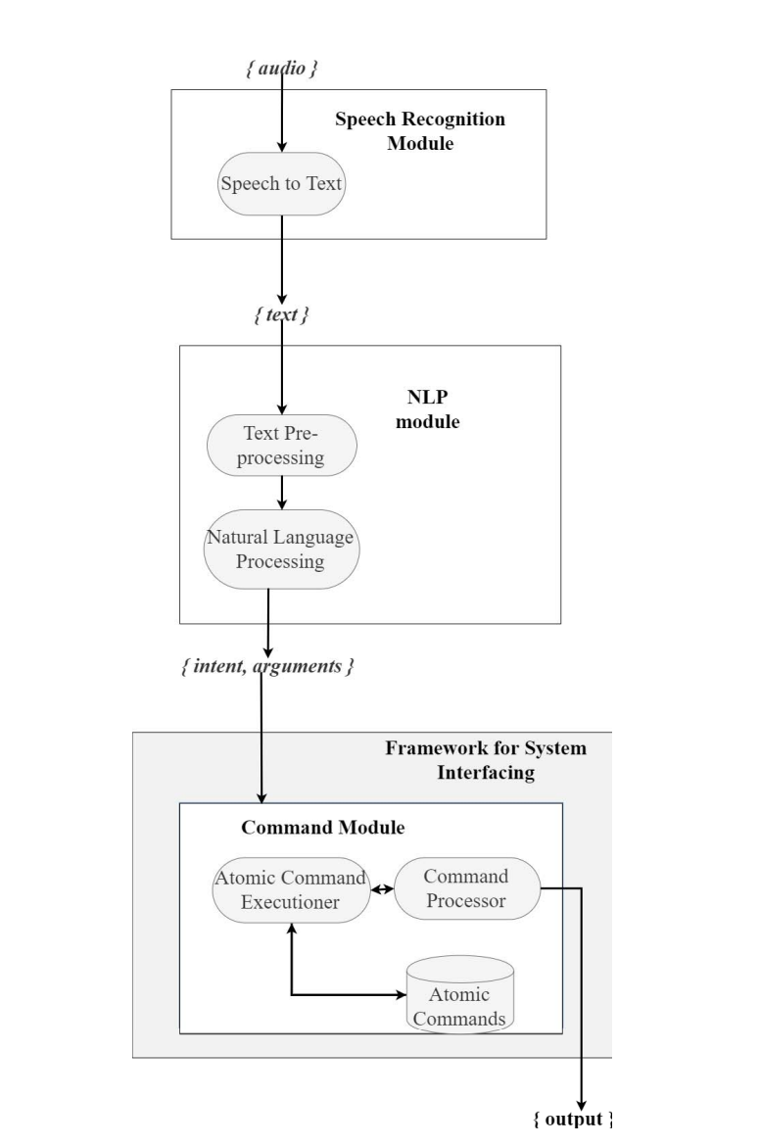
Literature Survey
A Framework for System Interfacing of Voice User Interface for Personal Computers
2020 Conference paper
This paper aims at generating intents and arguments
As shown in the image, text is given as input to the STT module
NLP module generates intents and arguments
Then pass to command Module, where the actions/operations are performed
Source:- A Framework for System Interfacing of Voice User Interface for Personal Computers
2020 Conference paper

Slide 15
Literature Survey
The Speech Recognizer library can be used in 2 variants.
Online and offline modes, only difference is in online mode audio is passed to Certain Api’s
On the other hand, offline mode makes use of the popular ’CMU Sphinx’ library for conversion of speech to text.

Slide 16
Literature Survey
Artificial intelligence based voice assistant
This paper goes in depth about how to get audio from user and process it with Acoustic Analysis
Acoustic Modelling - it represents that the elements were pronounced or not and what are the words which can complete these elements.
Pronunciation Modelling: That analyses the way, where how these elements are pronounced, it will check whether there is any accent or other peculiarities.
Language Modelling: This is often aimed toward finding contextual probabilities counting on what elements were captured.
Source:- Conference paper Artificial intelligence based voice assistant

Slide 17
Summary of Literature Survey
Models specified in these papers are having Accuracy rate of more than 94%
According to the survey, We may be able to increase performance, due to the fact that there will be less noise compare to what they’re using
And for the pdf to csv conversion we may have to implement our own algorithm for enhanced preprocessing, because our pdf are slightly inclined due to little stutter, while capturing the document using phone camera

Slide 18
Title of the Project
High Level Design

Slide 19
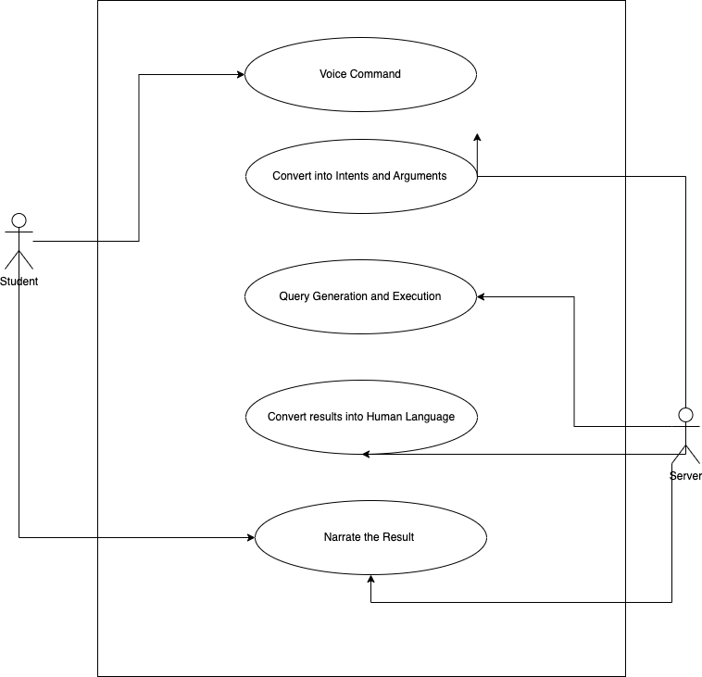
Title of the Project
Usecase diagram

Slide 20
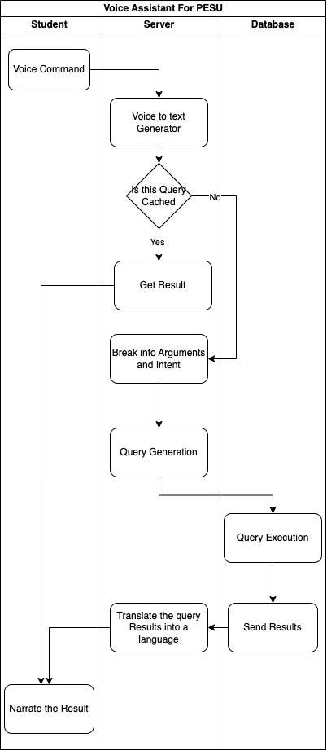
Title of the Project
Swimlane diagram

Slide 21
Title of the Project
Project Progress
We are to go with simple approaches.
What is the percentage completion of the project?
We have done Roughly 30 % completion of the project.

Slide 22
Upcoming phase
The main thing of part of our project is NLP, We are going to build a model for converting student query into executable query.
We are going to design a program to preprocess all the data that we have extracted from table.
Next part of our project is going to be database design and security, that is encryption
We have to look into handling of cached data.

Slide 23
References
Artificial_Intelligence-based_Voice_Assistant - Subhash S, Ullas A, Santhosh B, Siddesh S
A Framework for System Interfacing of Voice User Interface for Personal Computers Preet Dabre, Rohit Gonsalves, Raj Chandvaniya, and Anant V. Nimkar Department of Computer Engineering Sardar Patel Institute of Technology Mumbai, India
Table Detection and Extraction using OpenCV and Novel Optimization Methods – Nidhi, Karandeep Saluja, Asmita Mahajan, Akash Jadhav, Nakul Aggarwal
Web Scraping Approaches and their Performance on Modern Websites - Ajay Sudhir Bale, Naveen Ghorpade, Rohith S, S Kamales
A Method for Voice Activity Detection using K-Means Clustering - Atul Rohit Agarwal, Sourabh Tiwari, Sudhakar M S, Sankar Ganesh S

Slide 24
Thank You

